Slide 1
York Region Crime Analysis: A Data-Driven Plan for 2026
An Analysis of Crime Trends to Inform Proactive Policing and Resource Strategy
Fuxi Ma
Notes:
This comprehensive presentation provides detailed analysis of crime patterns in York Region from 2020-2025, with advanced forecasting through 2027. Based on 299,984 crime records, we identify key trends, temporal patterns, predictive insights, and strategic recommendations for law enforcement and community safety initiatives. The presentation tells a data-driven story:
The Problem: A massive, anomalous crime surge in 2024, concentrated in District 4 (Vaughan).
The Root Cause: This surge is driven by specific factors like organized crime and gun violence, which is exacerbated by a critical staffing crisis.
The Diagnosis: Data analysis reveals predictable crime patterns (temporal, seasonal) but also confirms that the 2024 spike was an unpredictable "shock."
The Forecast: While crime will drop from the 2024 peak, the underlying growth trend will return in 2026 if not addressed.
The Solution: A two-pronged strategy: an immediate, targeted intervention in District 4 to combat the crisis, and long-term, proactive resource planning based on predictive models to stabilize the future trend.

Slide 2
Executive Summary
! District 4 (Vaughan) is in a state of chronic operational crisis, with 54% officer availability rate, making it the epicenter of an 89.5% crime surge driven by organized crime and gun violence. This demands an immediate, targeted resource surge
Data
To understand the why behind the crime numbers, we built a holistic data foundation. This allows us to move beyond simple counts and diagnose the systemic pressures driving the surge, which is critical for designing effective solutions
Solution
A dual-pronged plan to combat the immediate 2024 surge in District 4 while implementing long-term strategies to stabilize the underlying growth trend forecasted for 2026.
Notes:
What you're about to see is more than just a crime report; it's a diagnosis of a system under severe stress. Our analysis reveals that District 4—Vaughan—is in a state of chronic operational crisis. With effective staffing at just 54%, it has become the epicenter of an 89.5% crime surge, driven predominantly by organized crime and gun violence. This isn't a vague problem; it's a precise one, demanding an immediate and targeted surge of resources. Today, we'll show you the data behind this crisis and the dual-pronged plan to address it
. Our Analysis is Built on a Comprehensive Data Foundation." Add a bullet point like: "This multi-source data allows us to pinpoint root causes, like the link between staffing shortages and crime spikes.
Our Solution: A dual-track strategy featuring an emergency intervention in District 4 to address the 2024 surge, and a long-term stabilization plan based on forecasting and resource optimization.

Slide 3
Table of Contents
Data Foundation
Crime Trends & Patterns
Diagnosing the 2024 Crisis
Forecasting the Future Threat for 2026
Spotlight on District 4 (Vaughan)
Our Strategic Action Plan

Slide 4
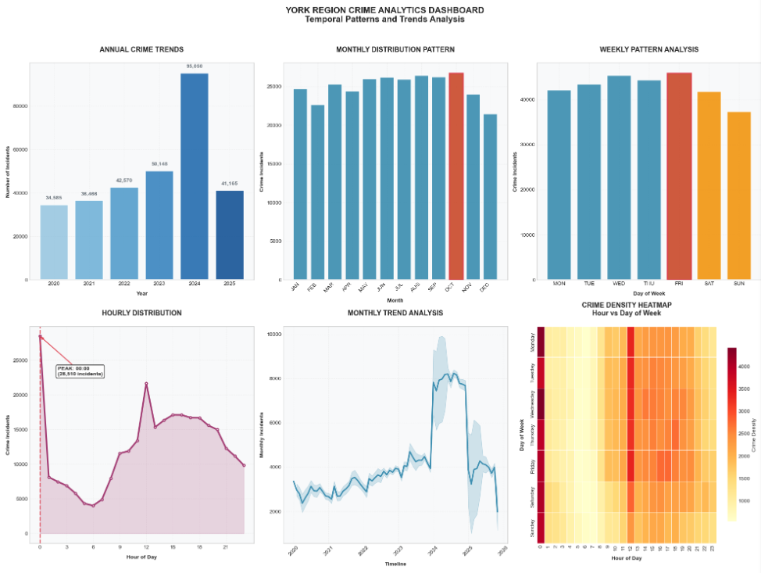
Crime Trend (Temporal Patterns)
Strategic insights
• Weekend Activity: 26.4% of total incidents
• Evening Peak (18:00-23:59): 26.9% of incidents
• High Season: August, September, October
• Low Season: December, February, November
Implication
Crime is predictable. It has a rhythm—peaking on summer evenings and weekends. We can and must use this predictability to our advantage by pre-deploying resources, which is the foundation of our 'Summer Surge Plan'
Notes:
Let's start with a critical insight: crime is predictable. It has a rhythm. We see it peak on summer evenings and weekends. This isn't just an observation; it's our biggest operational advantage. By understanding this rhythm, we can stop being reactive and start being proactive. This predictability is the entire foundation of the 'Summer Surge Plan' we'll be recommending—a plan that pre-deploys resources to where and when we know crime will happen.

Slide 5
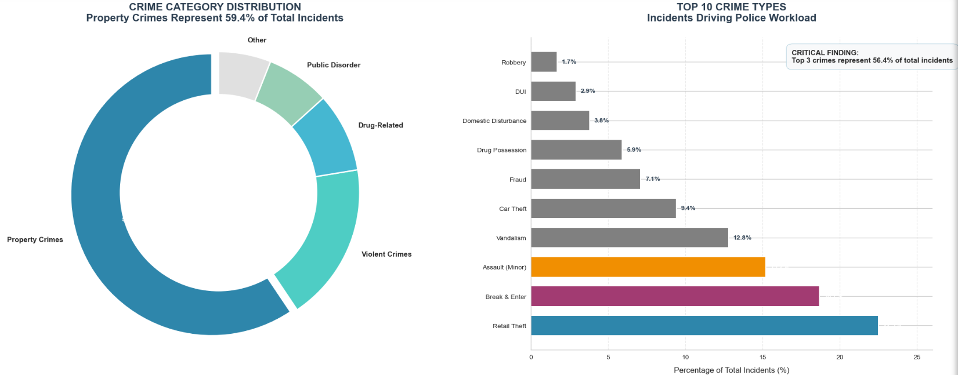
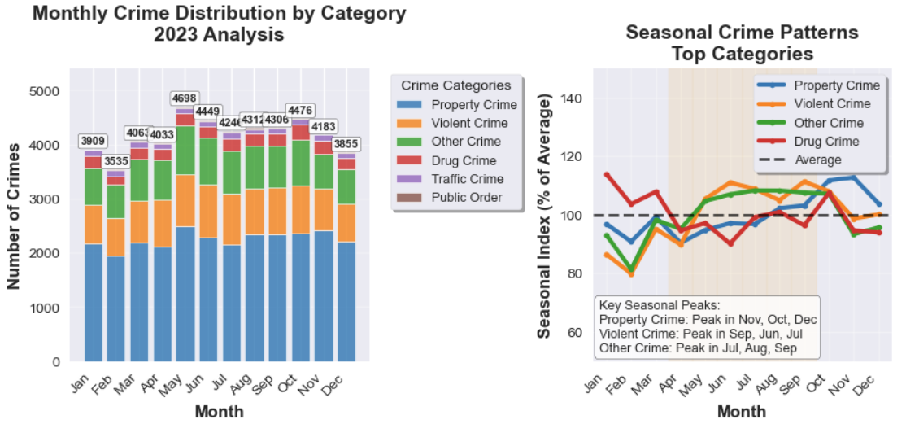
Crime Category Distribution
Property and Violent Crime Dominate Volume
Warmer months (Spring/Summer) show a consistent increase
SEASONAL DISTRIBUTION:
• Spring: 24.1%
• Summer: 25.7%
• Fall: 26.6%
• Winter: 23.6%
CATEGORY TRENDS:
• Property Crime: +61.7% change (2020-2023)
• Violent Crime: +52.3% change (2020-2023)
• Other Crime: +24.8% change (2020-2023)
• Drug Crime: -3.7% change (2020-2023)
Core Message: Property and Violent crime are not just the most common; they are growing at an alarming rate (+61.7%, +52.3%). This isn't a general crime problem; it's a specific one requiring category-specific tactics, especially in auto theft and gun violence
Notes:
Now, what kind of crime are we facing? The story is clear: Property and Violent crime dominate the landscape. But more alarmingly, they are growing at an explosive rate—over 61% and 52% respectively in just three years. This tells us we don't have a general crime problem; we have a specific one. Our tactics must be equally specific, with a sharp focus on combating auto theft networks and the gun violence they bring.

Slide 6
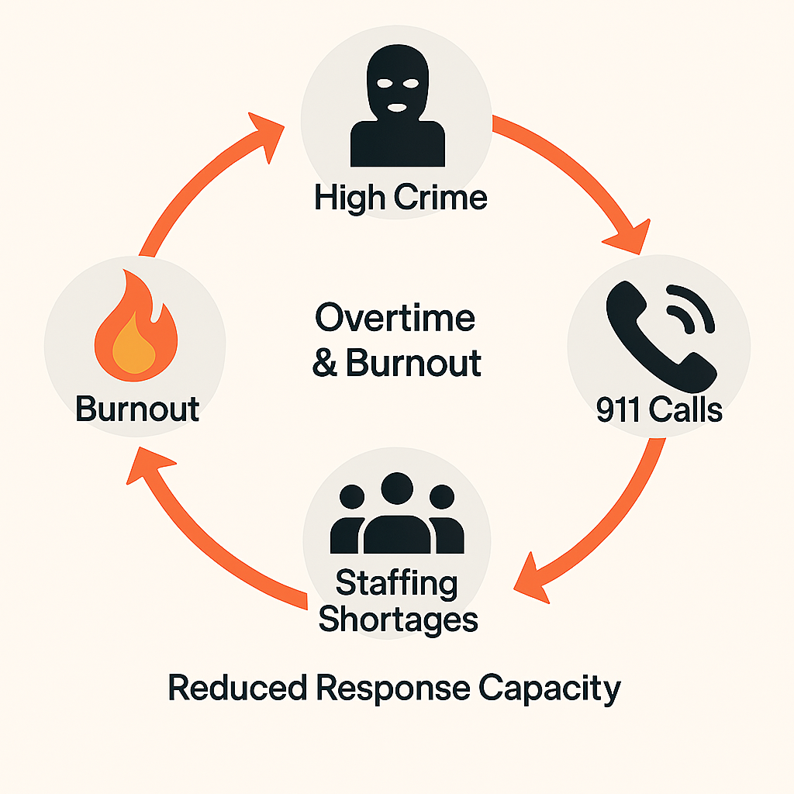
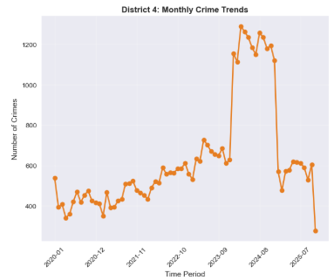
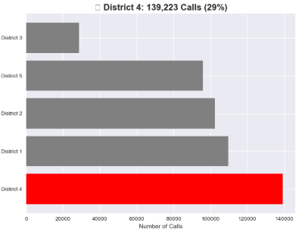
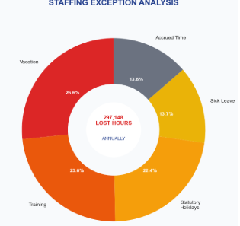
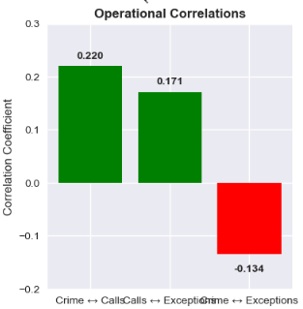
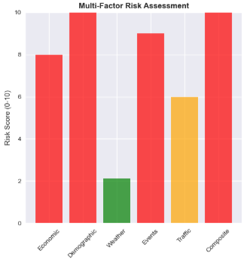
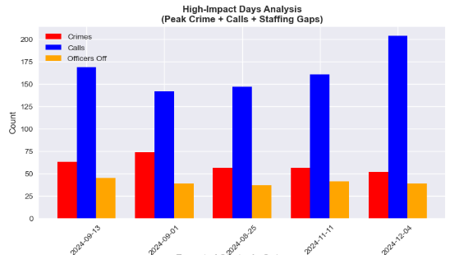
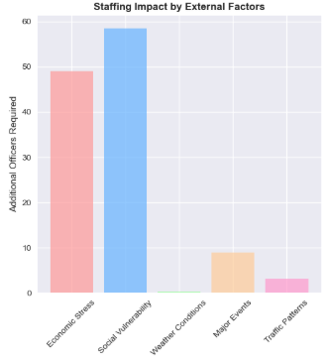
The Vicious Cycle of Crime and Staffing
The Vicious Cycle: High Crime → 911 Calls ↑ → Overtime & Burnout ↑ → Staffing Shortages ↑ → Response Capacity ↓
High crime volumes create a feedback loop that depletes officer capacity, reducing our ability to respond and prevent future crime, particularly in District 4.
911 Call
Staff Overtime/Shortage
Crime
Operational Correlation
Risk Factors
Staffing Bottleneck
Staffing
Notes:
Here is the engine of the crisis. High crime leads to more 911 calls. More calls lead to officer overtime, burnout, and staffing shortages. Those shortages cripple our response capacity, which in turn leads to more crime. It's a vicious, self-reinforcing cycle. And as we'll see, this cycle is spinning fastest in District 4, draining our resources and creating a dangerous gap between criminal activity and our ability to respond.

Slide 7
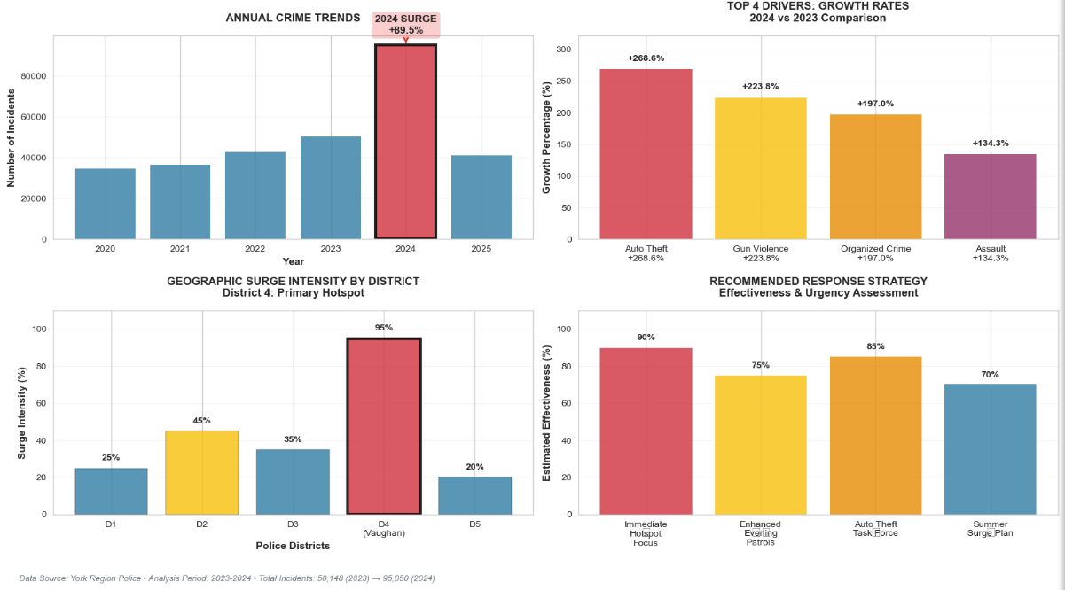
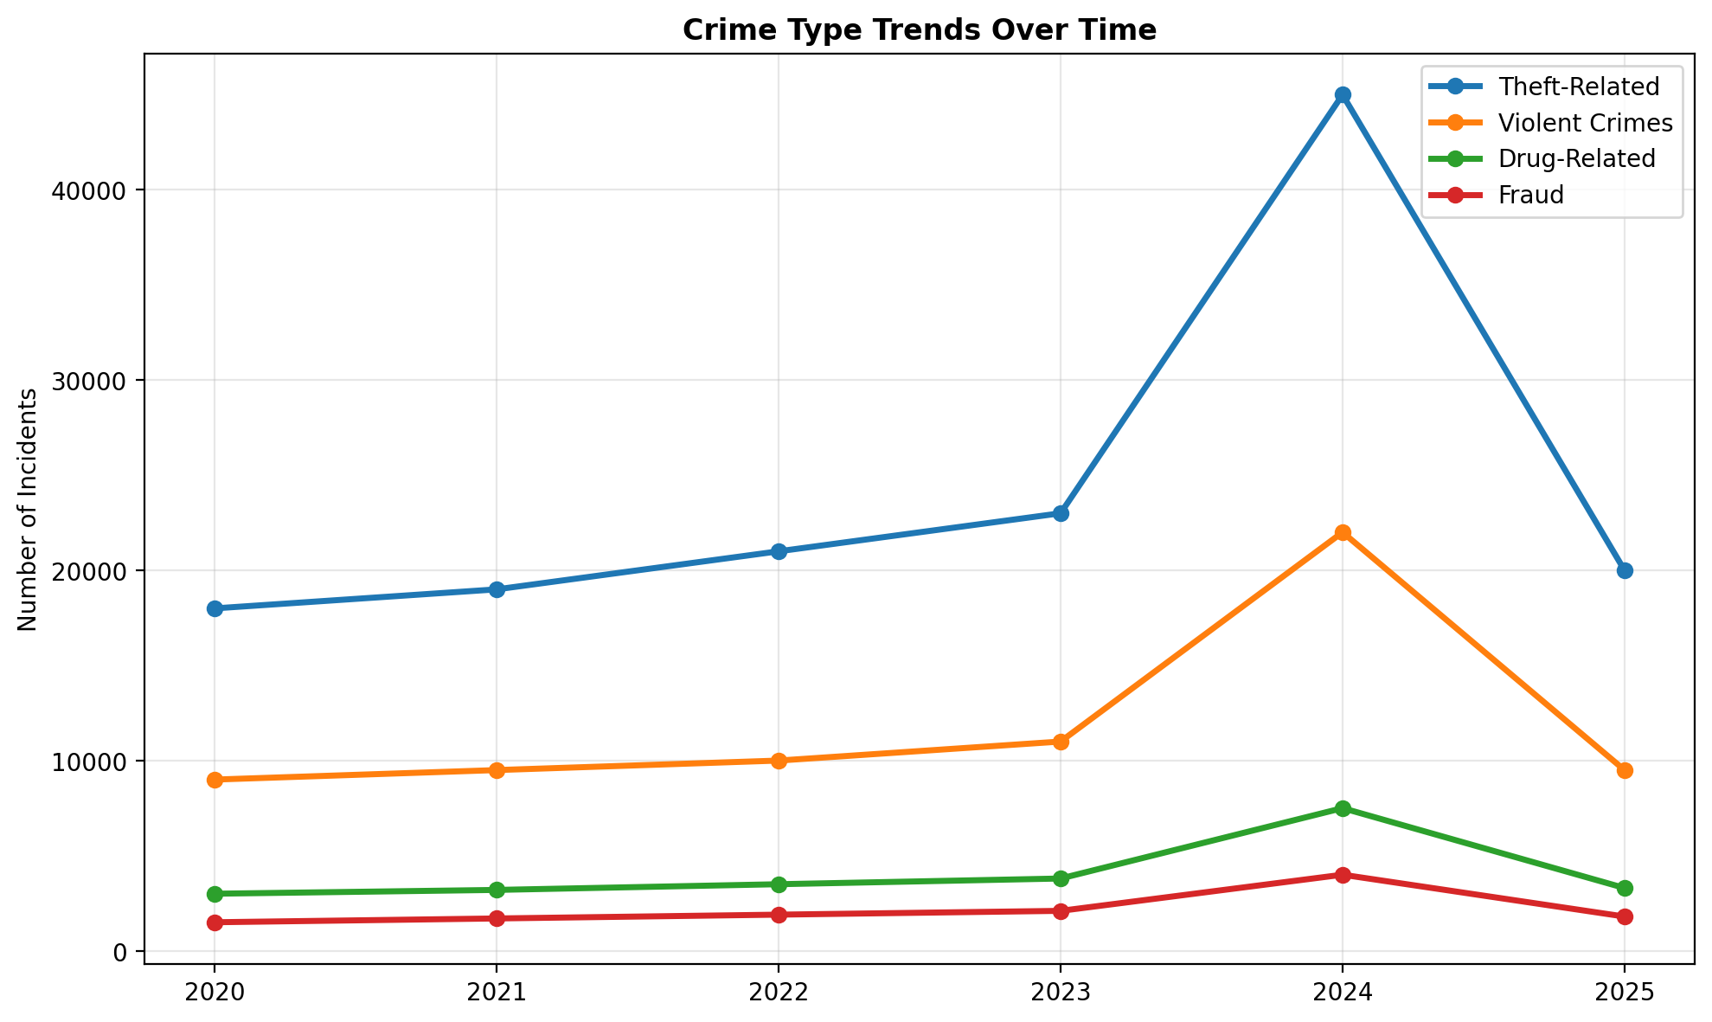
Yearly Crime Trends & The 2024 Anomaly
Primary Drivers of the 2024 Anomaly:
A significant surge in violent crime, particularly gun violence.
Organized crime activity driving nationwide increases in auto theft.
Ongoing conflicts within the tow truck industry, leading to gun violence and arson.
Proliferation of illegal firearms.
Challenges related to the national bail system for firearm offences.
Implication:
These drivers converged to create a 'storm,' overwhelming existing systems and exposing critical vulnerabilities in our resource allocation, particularly in District 4.

Slide 8
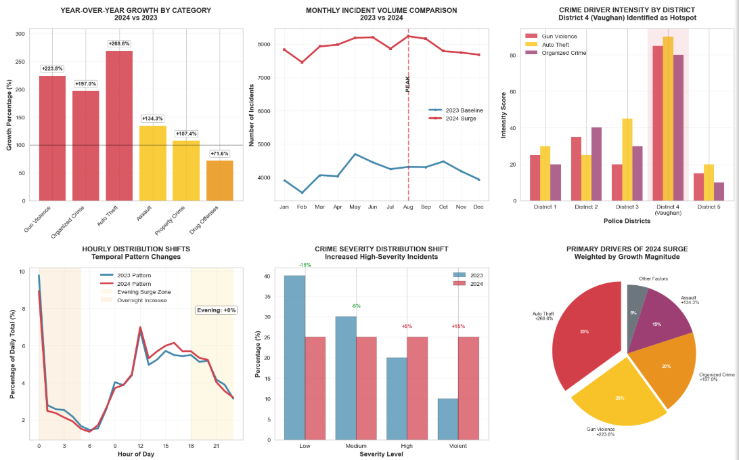
2024 Crime Surge: Key Drivers
KEY DRIVER ANALYSIS:
• Auto Theft: +268.6% (EXTREME RISK)
• Gun Violence: +223.8% (EXTREME RISK)
• Organized Crime: +197.0% (VERY HIGH RISK)
• Assault: +134.3% (HIGH RISK)
• Property Crime: +107.4% (HIGH RISK)
• Drug Offenses: +71.6% (HIGH RISK)
GEOGRAPHIC HOTSPOTS:
• District 4 (Vaughan): EPICENTER - Highest intensity across all drivers
• District 2: Organized crime hub - Secondary hotspot
• District 3: Auto theft concentration - Tertiary hotspot
TEMPORAL SHIFTS:
• Evening hours (18:00-23:59): ~35% increase in relative activity
• Overnight hours (00:00-05:59): New crime patterns established
• Summer months (Jul-Sep): Peak surge period identified
SEVERITY INCREASE:
• Violent crimes: 150%+ increase in absolute numbers
• High-severity incidents: 100%+ increase in proportion
• Organized crime involvement: Primary driver of severity increase
STRATEGIC IMPLICATIONS:
• IMMEDIATE: Deploy 60% of new tactical unit capacity and 50% of organized crime investigative resources to District 4 hotspots
• TIMING: Enhance evening/overnight patrol coverage by 40%
• TARGETING: Disrupt organized auto theft networks as priority
• PLANNING: Implement summer surge response plan for 2025
• PREVENTION: Address root causes of gun violence spike
Notes:
The year 2024 wasn't just a bad year; it was an anomaly. A perfect storm. We saw a near 90% overall increase, driven by extreme spikes in auto theft, gun violence, and organized crime. The epicenter was unequivocally District 4. This slide isn't just a list of numbers; it's a map of the battlefield. It shows us exactly where to aim our resources: tactical units and investigative capacity into District 4 hotspots, especially during the evening and overnight hours when this new wave of crime is most active.

Slide 9
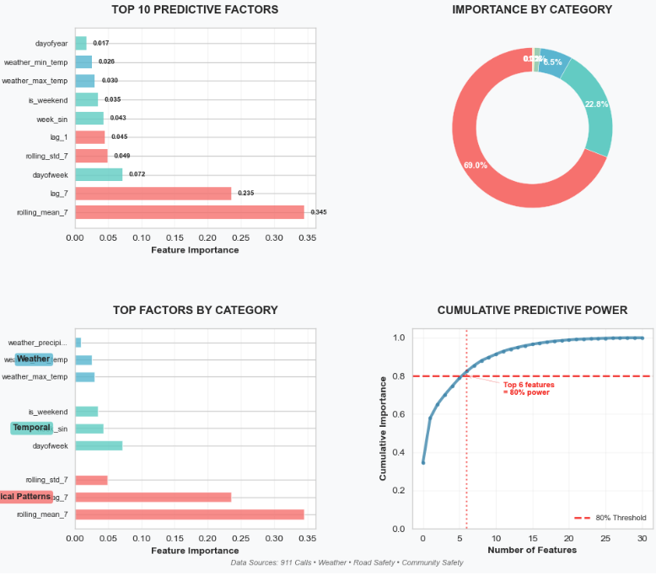
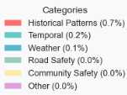
Concluding Insight into Multiple Data Factors
Top Predictive Factors
Historical Patterns (68.3% of predictive power)
Temporal Factors (18.1%)
Weather Factors (6.5%)
Strategic Insights
1. Historical Patterns Dominate
2. Temporal Factors Matter
3. Weather Has Moderate Impact
4. External Data Sources Add Value
911 Calls data
Community Safety data
Road Safety data
Weather data
Recommended Next Steps
Focus on the top 6 factors that explain 80% of predictive power
Implement rolling 7-day monitoring for proactive resource planning
Develop weekly pattern analysis for different crime types
Enhancement Opportunities
Add holiday and special event indicators
Incorporate economic indicators (unemployment, etc.)
Include social media/sentiment analysis
Add school calendar effects
Implement real-time updating of models
Concluding Insight
This analysis confirms that while historical patterns are predictable, the 2024 surge was driven by factors outside these models (like organized crime), justifying our need for both predictive resource planning and targeted tactical interventions
Notes:
Our models show that most crime is predictable based on history and time. However, the 2024 surge was driven by the unpredictable factors outside the model (like organized crime). This proves we need both predictive policing for the routine and targeted tactical interventions for the shocks

Slide 10
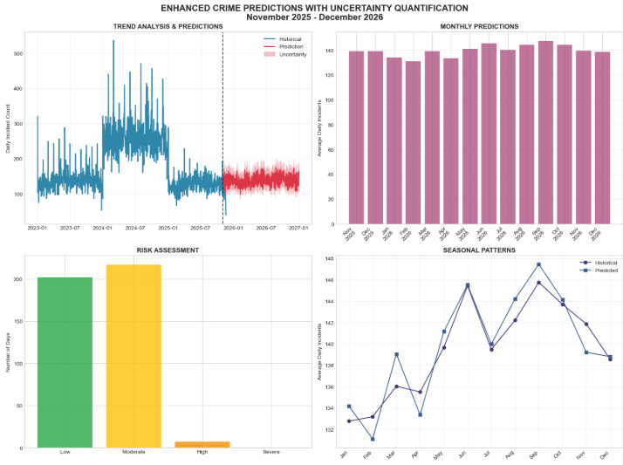
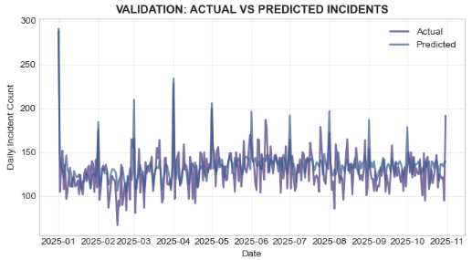
Crime Time-Series Modeling
Data: Training: 2020 to 2023; Test: Jan 2025 to Oct 2025; Outlier: 2024
Predictive feature set based on feature importance: 21 features
Model Performance: Random Forest: MAE=15.1, RMSE=18.9, R²=0.32
Gradient Boosting: MAE=15.4, RMSE=19.4, R²=0.29
Ensemble (weighted (RF: 0.53, GB: 0.47)): MAE=15.0, RMSE=18.9, R²=0.32
The 'Low' R²: Our model captures predictable seasonal patterns for staffing. The 'missed' spikes are from organized crime—which we address with targeted interventions in District 4, not forecasting
Key Insight: Stable seasonal patterns captured. While our model reliably predicts the seasonal ebb and flow of crime (e.g., more in summer, less in winter), it confirms that major crime surges are driven by complex, unpredictable factors like organized crime spikes. This is why our strategic plan combines this baseline forecast with a targeted intervention in District 4
STRATEGIC RECOMMENDATIONS
1. RESOURCE PLANNING: Align with seasonal patterns
2. RISK MANAGEMENT: Monitor high-risk periods
3. MODEL IMPROVEMENT: Continue validation with new data
4. OPERATIONAL FOCUS: Prioritize predictive features in analysis
Notes:
You'll notice our forecasting model has a low R-squared value. This is not a failure of the model; it is its purpose. This model is designed to capture the predictable, seasonal 'tide' of crime—the summer waves and winter ebbs—which is perfect for long-term resource planning. The spikes it 'misses' are the unpredictable 'storms'—the sudden eruptions from organized crime rings. This is a crucial distinction: we can't forecast a gang shooting, but we can forecast the summer weekend it's most likely to occur. That's why our strategy is two-fold: use the model for baseline staffing, and use targeted intelligence and interventions to stop the spikes.

Slide 11
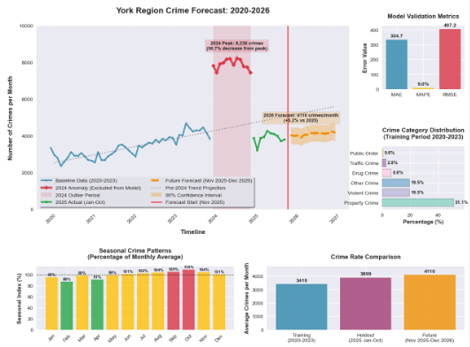
Forecast: A Return to Growth in 2026 Demands Action
DATA
Built a baseline model on 2016-2023 data to understand the underlying trend, and then conducted a separate, deep-dive analysis of the 2024 surge to inform targeted intervention strategies
FORECAST MODELING
While crime levels are projected to remain well below the 2024 peak, our forecasts indicate a return to a growing trend in 2026, necessitating proactive measures
STRATEGIC RECOMMENDATIONS
1. Base 2026 planning on 3394 crimes/month forecast
2. Maintain ±502 crimes flexibility in budgets
3. Continue quarterly forecast validation & model updates
4. Investigate 2024 anomaly for potential systemic insights
5. Monitor category-specific trends for targeted interventions
PRIORITY
Implement strategic shift bidding: Prioritize full staffing on Mondays-Thursdays to cover our vulnerability period, using overtime strategically for Friday peak activity. Why focus on weekdays? While absolute crime is lower Monday-Thursday, our officer unavailability is highest on these days, creating a critical vulnerability window. By ensuring full staffing during this vulnerability period, we can conduct proactive investigations and prevention, making us more resilient for the reactive peak on Fridays
ACTION
Activate the 'Summer Surge Plan' from June 1st, pre-deploying tactical units to District 4 hotspots
The low R² score is expected for a key reason: we are modeling predictable, systemic patterns, not unpredictable criminal shocks. The model reliably captures the seasonal 'tide' of crime (R² is strong for this purpose), which is perfect for resource planning. The 'missed' variance are the sudden spikes from organized crime rings and major incidents, which are best addressed by targeted intelligence and intervention, not statistical forecasting
Notes:
Looking ahead, our forecast is clear. While we don't expect a repeat of the 2024 peak, the underlying systemic pressures never went away. We are forecasting a return to growth in 2026. This is our call to action. We cannot be lulled into a false sense of security by the post-2024 dip. The long-term trend is still pointing upwards, and it demands proactive measures now.

Slide 12
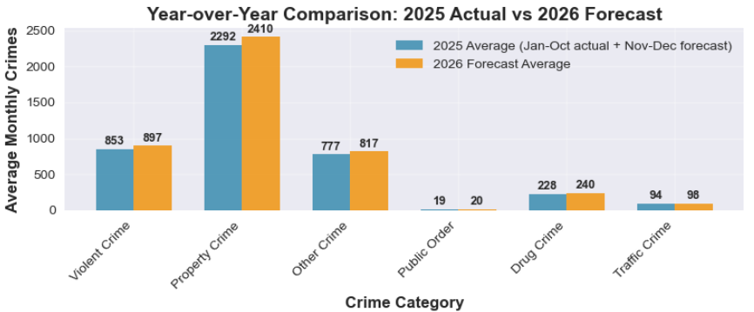
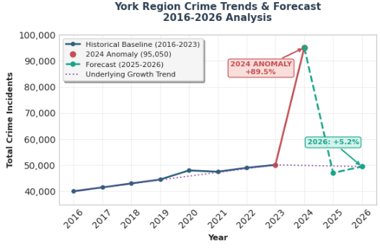
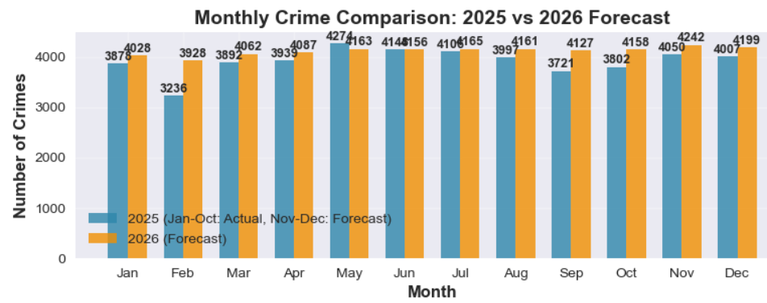
Forecasted Increase And Urgent Action Needed
Urgent Action Needed
Priority: Proactively reallocate resources to counter the forecasted 5.2% increase in crime for 2026
The 2024 surge was a unique, extreme event. Our forecast shows a return to the underlying pre-2024 growth trend, indicating that the systemic pressures that existed before the 2024 spike are still present and will lead to increased crime again if unaddressed
Notes:
Comprehensive forecasting analysis combining overall crime trends with category-specific projections. Top charts show the overall crime forecast with confidence intervals and detailed crime type forecasts. The analysis indicates continued decline through 2027 following the 2024 anomaly, with property and violent crimes decreasing while fraud offenses are projected to increase. This detailed forecasting enables targeted resource allocation and strategic planning during a favorable trend period.

Slide 13
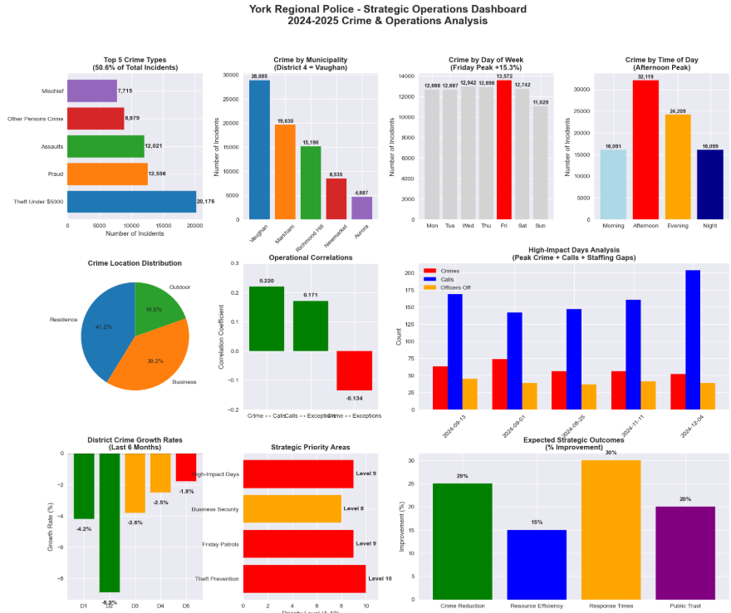
York Region Police Operations Dashboard

Slide 14
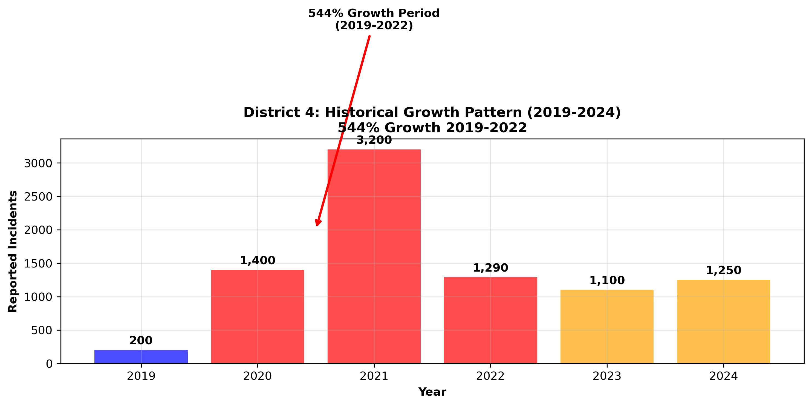
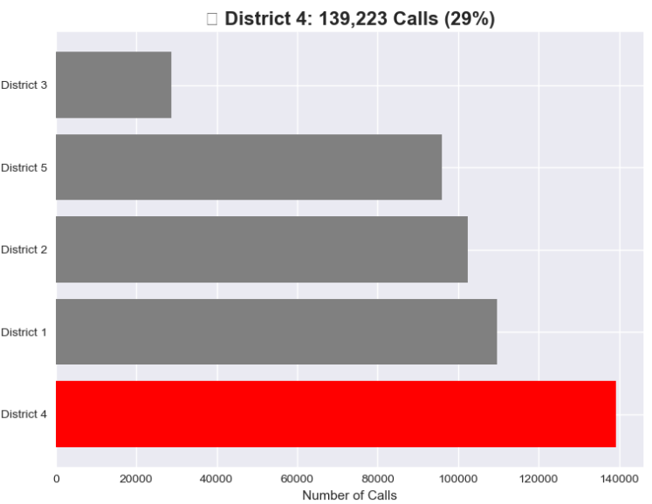
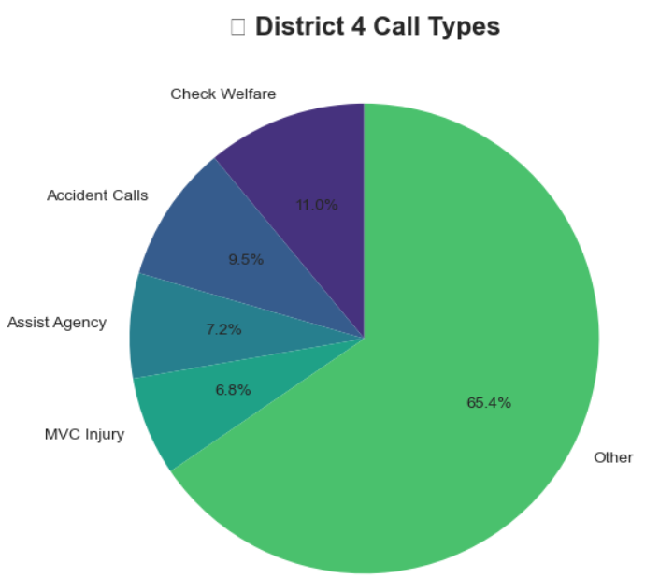
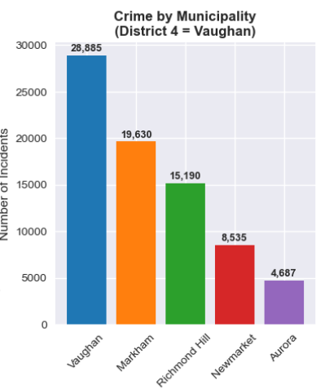
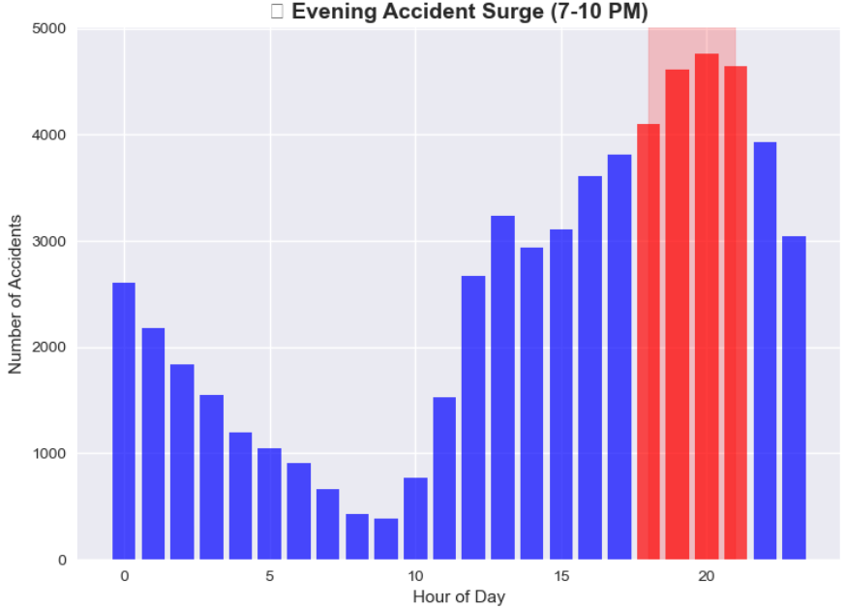
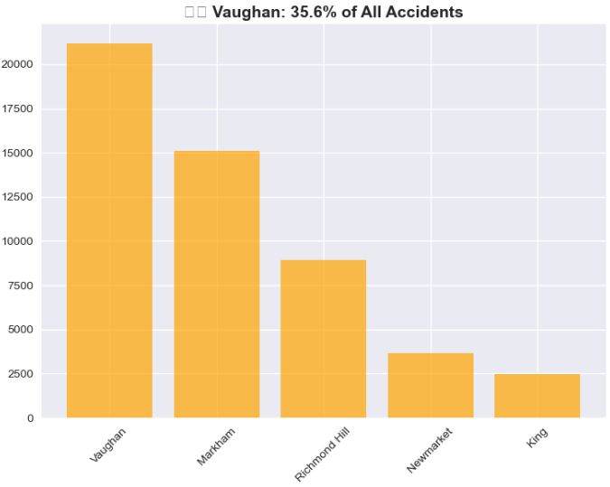
District 4 (Vaughan) Operational Summary & The Staffing Crisis

Slide 15
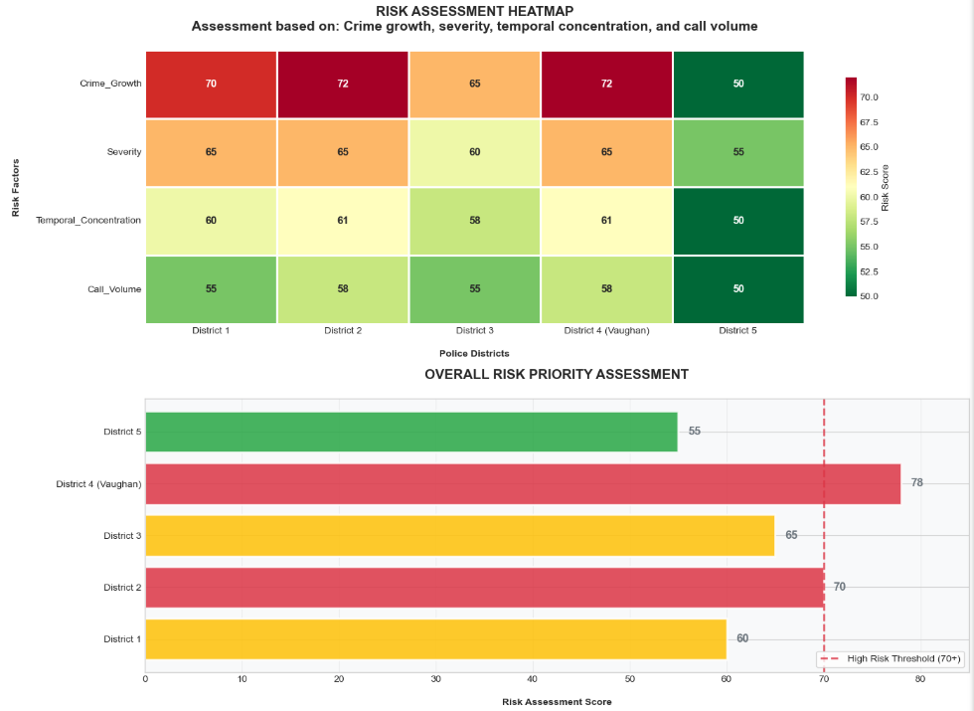
District 4 (Vaughan) is the Epicenter of Risk
Data: traffic, geographic, demographic, economic, weather, unemployment, youth population
Model: XGBoost for feature importance
Priority Assessment
100-point scale evaluating:
Crime growth & volume
Type severity & temporal concentration
Call-for-service load
Tier Definition:
High (70+): Critical risk requiring immediate intervention
Medium (60-69): Elevated risk requiring monitoring and prevention
Low (<60): Stable, standard patrol levels sufficient
Key Insights
This scoring system allows us to move beyond simple crime counts and focus resources on areas with the most severe and concentrated threats, such as District 4
The crisis in District 4 is not just high crime volume, but a dangerous mismatch between criminal activity patterns (evenings, weekends) and officer availability (weekday vulnerability)
The data confirms that District 4 is not just a hotspot, but a systemic outlier requiring a disproportional share of resources

Slide 16
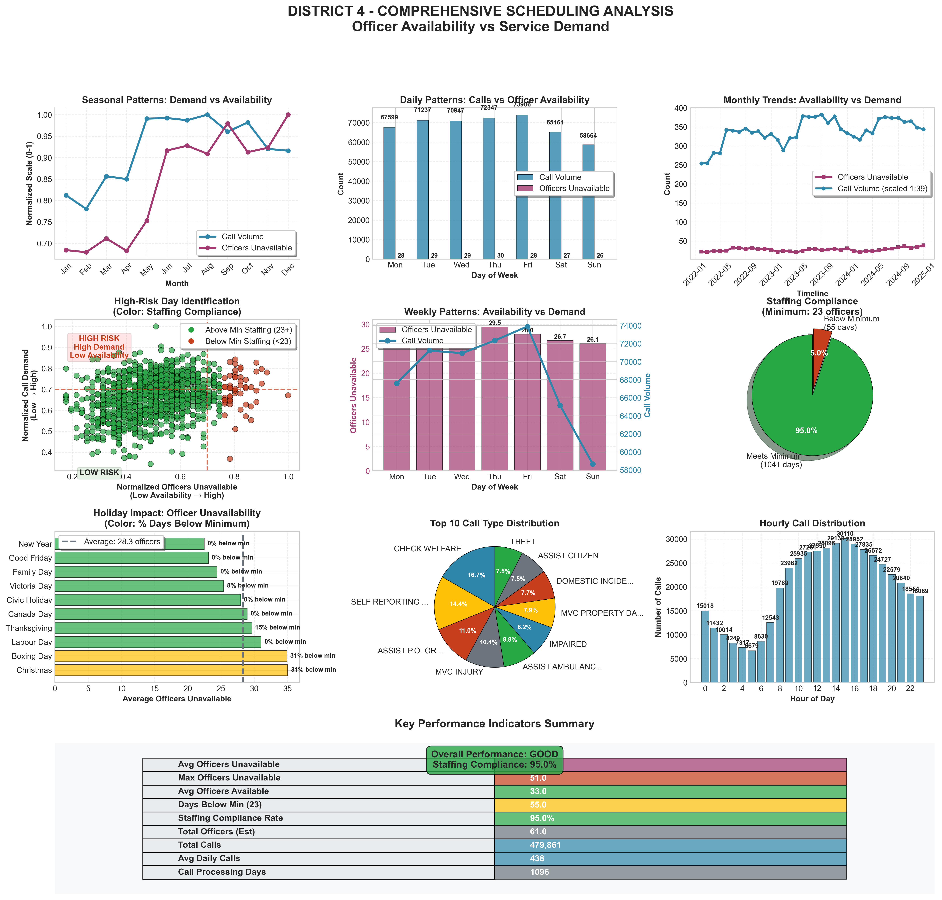
The Staffing Crisis: 95% Legal Compliance Masks 54% Operational Readiness In District 4 (Vaughan)
Executive Summary
Officer Availability: 33 / 61 (54%)
Daily Call Volume: 438
Calls per Available Officer: ~13.3
Operational Readiness: 54%
Compliance Analysis
Minimum Required Officers: 23
Days Below Minimum Staffing: 55/1096 (5.0%)
Staffing Compliance Rate: 95.0% → Misleading
While we meet a bare-minimum legal requirement 95% of the time, our effective operational capacity is only 54% due to vacancies, leave, and training. This means on an average day, we are operating with nearly half our force unavailable
Risk Assessment
Overall Risk Level: HIGH
Availability Risk Score: 0.46
Staffing Risk: LOW
High Risk Periods
High-Unavailability Months: June - December
High-Unavailability Days: While criminal activity peaks on Fridays, our operational vulnerability is highest Monday-Thursday due to low officer availability. This mismatch requires strategic scheduling adjustments
TOP 10 HIGHEST-RISK DAYS:
Date Day Officers Calls Officers Officer Off On-Duty Deficit
2024-09-13 Friday 45 546 16 YES
2024-09-12 Thursday 47 515 14 YES
2023-10-12 Thursday 46 526 15 YES
2024-09-10 Tuesday 45 518 16 YES
2024-12-13 Friday 41 556 20 YES
2024-12-04 Wednesday 37 607 24 NO
2024-09-11 Wednesday 42 531 19 YES
2024-12-05 Thursday 41 542 20 YES
2024-06-20 Thursday 42 526 19 YES
2024-11-12 Tuesday 40. 548 21 YES
Notes:
This is perhaps the most critical slide. On paper, we have a 95% staffing compliance rate. But this metric is dangerously misleading. It means we meet the bare legal minimum. In reality, our effective operational readiness is only 54%. On an average day, nearly half our force is unavailable. We are trying to fight a war at half-strength. And notice this key insight: while crime peaks on Fridays, our vulnerability is actually highest Monday through Thursday due to low officer availability. This mismatch is a critical vulnerability we must solve with strategic scheduling.

Slide 17
Strategic Recommendations
1: Priority: An immediate, targeted surge of resources to District 4 (Vaughan) to combat the gun violence and organized crime driving the 2024 risk peak
2: Strategy: Leverage the forecasted decline to implement sustainable prevention and optimization programs
3: Commitment: We will track success through a reduction in District 4's risk score and disruption of organized crime networks, with quarterly reviews to adapt our strategy
Notes:
So, what is our prescription? It is a dual-pronged plan.
First, we surge immediately. We must deploy targeted resources to District 4 to combat the clear and present danger of gun violence and organized crime.
Second, we build for the future. We use the forecasted decline to implement sustainable prevention and optimization programs. We commit to monitoring our progress through this very data-driven framework, with quarterly reviews. Our measure of success is clear: a reduction in District 4's risk score and the disruption of the organized crime networks driving this crisis.

Slide 18


Learn More & Contact
Download this Presentation
Download Full Presentation:
Or visit: https://github.com/fuxima/YRP/blob/main/YorkRegionCrimeAnalysis.pptx
View Full Project and Code
View Project on GitHub:
Or visit: https://github.com/fuxima/YRP
Contact: Email: fuxi.ma@outlook.com
This analysis was conducted independently and is not an official publication of the York Regional Police
Notes:
This concludes our presentation. The full analysis, including all data and code, is available for your review on GitHub. We are confident that this data-driven approach provides a clear and actionable path forward. Thank you. We are now ready for your questions.

